Slide 1
BASIC ELECTRONICS
(24B11EC111)
Unit-1
Lecture-6
(Methods of DC Circuit Analysis Contd.)

Slide 2
CONTENTS
Mesh Current Analysis with Current and Voltage Sources
Mesh Current Analysis with Supermesh approach
Problem
References

Slide 3
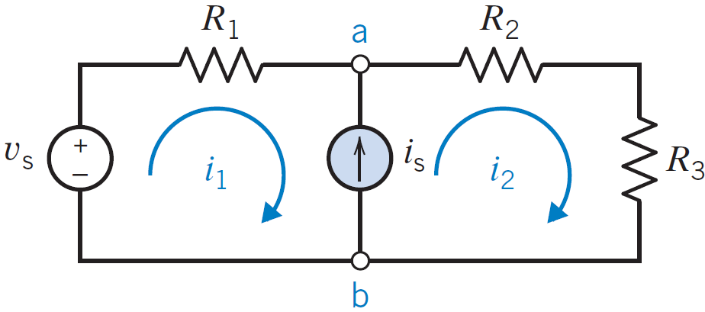
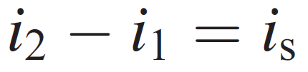
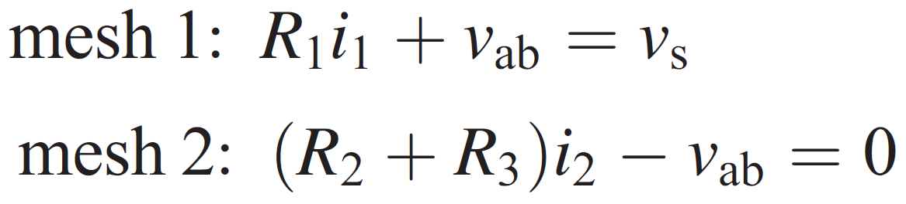
Mesh Current Analysis with Current and Voltage Sources
we have a current source i_{s} that has an unknown voltage v_{ab} across its terminals. We can readily note that
by writing KCL at node a.
The two mesh equations are

Slide 4

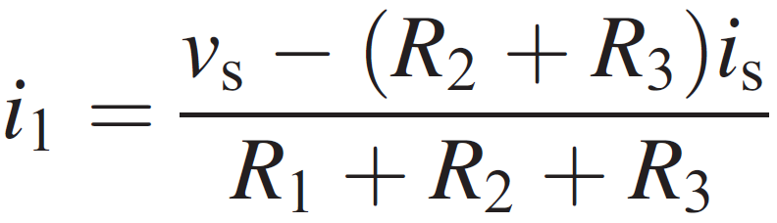
Mesh Current Analysis with Current and Voltage Sources
we eliminate v_{ab}, obtaining

Slide 5
Mesh Current Analysis
If the current source influences only one mesh current, we write the equation that relates that mesh current to the current source current and write the KVL equations for the remaining meshes.
If the current source influences two mesh currents, we write the KVL equation for both meshes, assuming a voltage v_{ab} across the terminals of the current source. Then, adding these two mesh equations, we obtain an equation independent of v_{ab}.

Slide 6
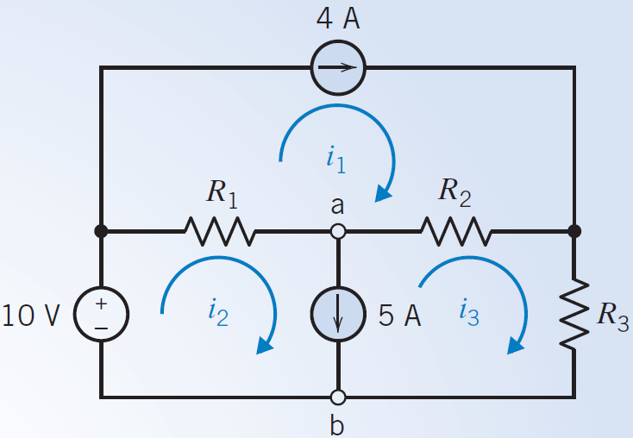
Problem
Consider the circuit of Figure where R₁ = 1 Ω, R₂ = 1 Ω and R₃ = 2 Ω. Find the three mesh currents.

Slide 7


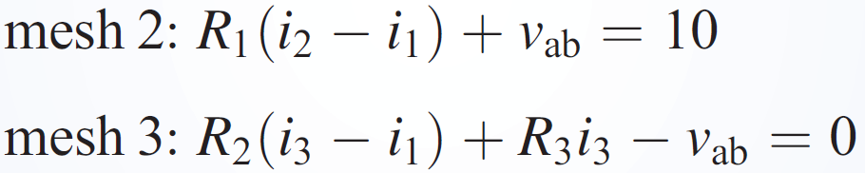
Problem - Solution
Because the 4-A source is in mesh 1 only, we note that
For the 5-A source, we have
Writing KVL for mesh 2 and mesh 3, we obtain

Slide 8
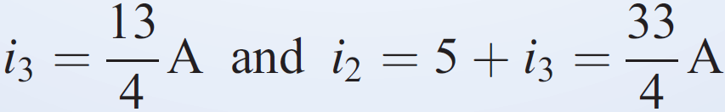
Problem - Solution
We substitute i₁ = 4 , and add both equations
From Eq. i₂ = 5 + i₃ , we have
Using the values for the resistors, we obtain

Slide 9
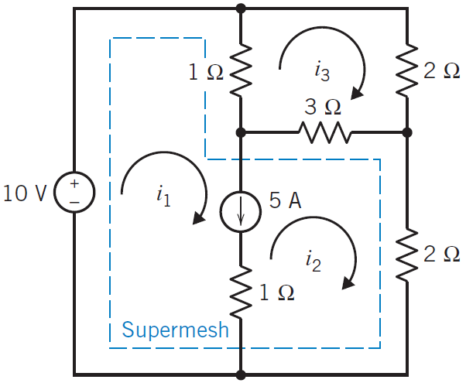
Mesh Current Analysis with Current and Voltage Sources
Another technique for the mesh analysis method when a current source is common to two meshes involves the concept of a supermesh.
A supermesh is one larger mesh created from two meshes that have an independent or dependent current source in common, as shown in Figure.
FIGURE - Circuit with a supermesh that incorporates mesh 1 and mesh 2. The supermesh is indicated by the dashed line.

Slide 10
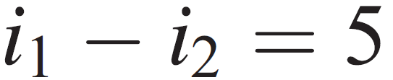
Mesh Current Analysis – Supermesh Approach
The 5-A current source is common to mesh 1 and mesh 2.
The supermesh consists of the interior of mesh 1 and mesh 2.
Writing KVL around the periphery of the supermesh shown by the dashed lines, we obtain
For mesh 3, we have
Finally, the equation that relates the current source current to the mesh currents is

Slide 11
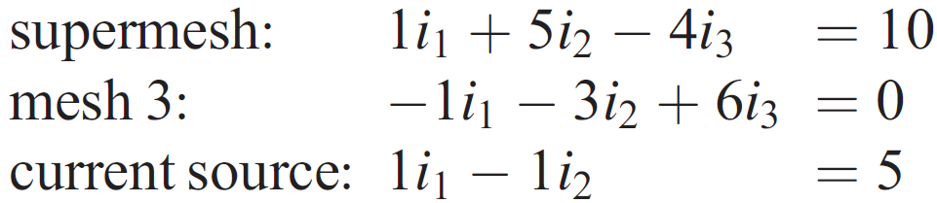
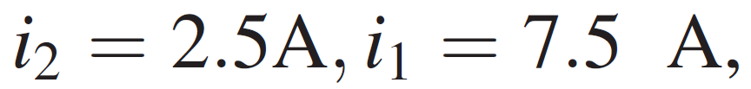

Mesh Current Analysis – Supermesh Approach
Then the three equations may be reduced to
Therefore, solving the three equations simultaneously, we find that

Slide 12
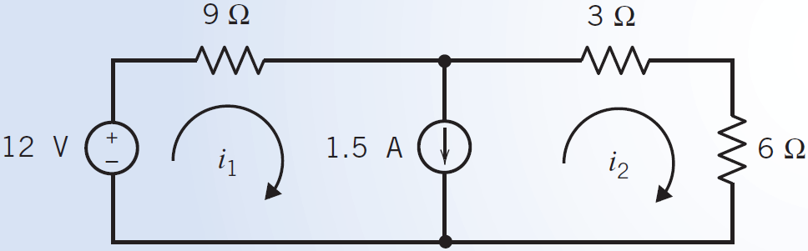
Practice Problem
Determine the values of the mesh currents i₁ and i₂ for the circuit shown in Figure

Slide 13
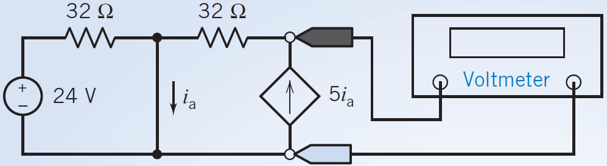
Mesh Current Analysis with Dependent Sources - Example
When a circuit contains a dependent source, the controlling current or voltage of that dependent source must be expressed as a function of the mesh currents.
Problem: Consider the circuit shown in Figure. Find the value of the voltage measured by the voltmeter.

Slide 14
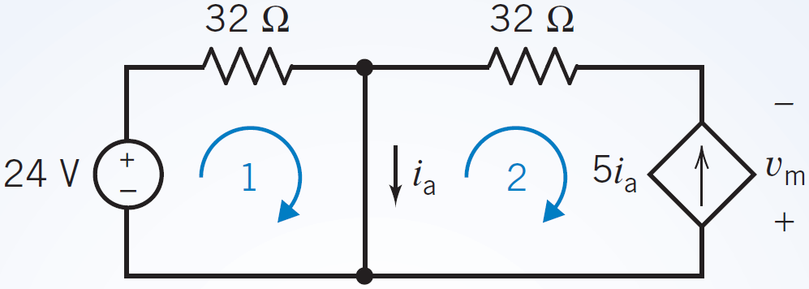


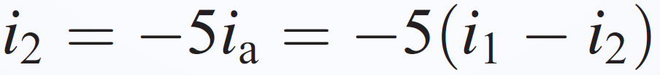
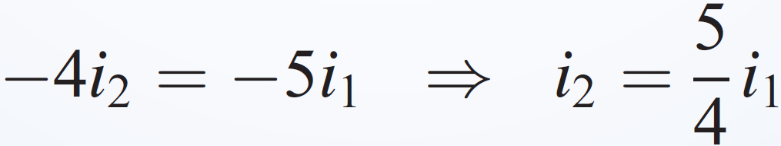
Problem - Solution
Let i₁ and i₂ denote the mesh currents in meshes 1 and 2, respectively.
The controlling current of the dependent source, i_{a}, is the current in a short circuit. The short-circuit current can be expressed in terms of the mesh currents as
The reference direction of the dependent source current does not agree with the reference direction of i₂. Consequently,

Slide 15
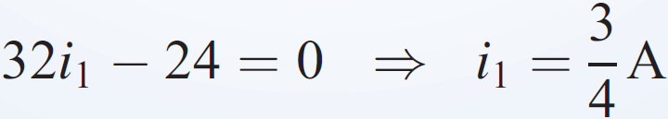
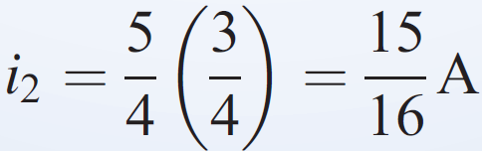
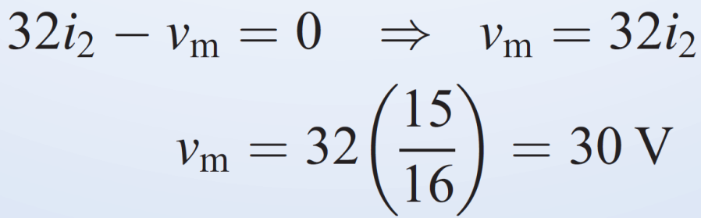
Problem - Solution
Apply KVL to mesh 1 to get
Apply KVL to mesh 2 to get

Slide 16
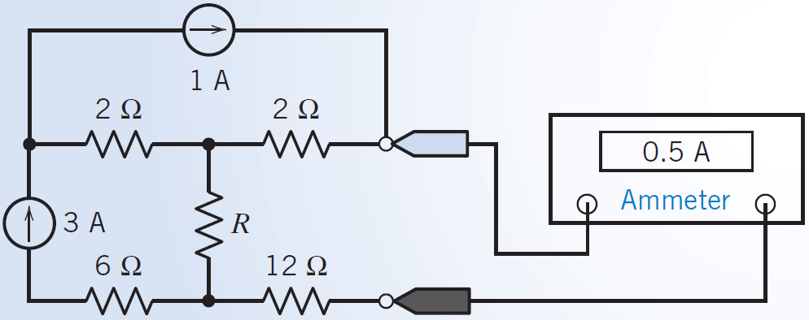
Problem
Consider the circuit shown in Figure. Find the value of the resistance, R.

Slide 17
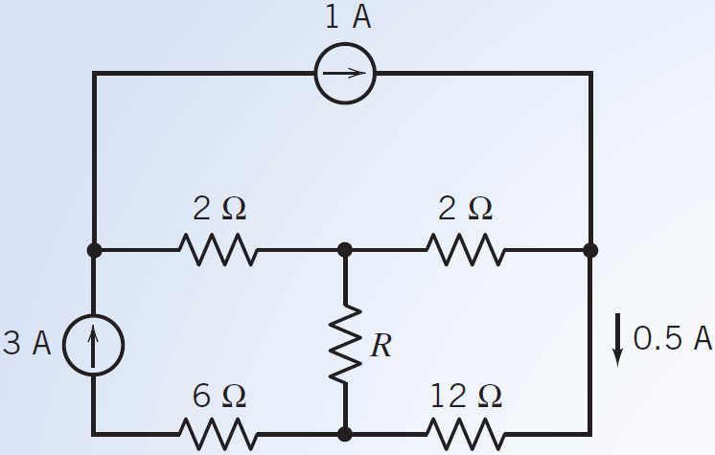
Problem - Solution
Figure shows the circuit after replacing the ammeter by an equivalent short circuit and labeling the current measured by the ammeter.
This circuit can be analyzed using mesh equations or using node equations.
To decide which will be easier, we first count the nodes and meshes.
This circuit has five nodes.
Selecting a reference node and then applying KCL at the other four nodes will produce a set of four node equations. The circuit has three meshes.
Applying KVL to these three meshes will produce a set of three mesh equations. Hence, analyzing this
circuit using mesh equations instead of node equations will produce a smaller set of equations. Further, notice that two
of the three mesh currents can be determined directly from the current source currents. This makes the mesh equations
easier to solve. We will analyze this circuit by writing and solving mesh equations.

Slide 18
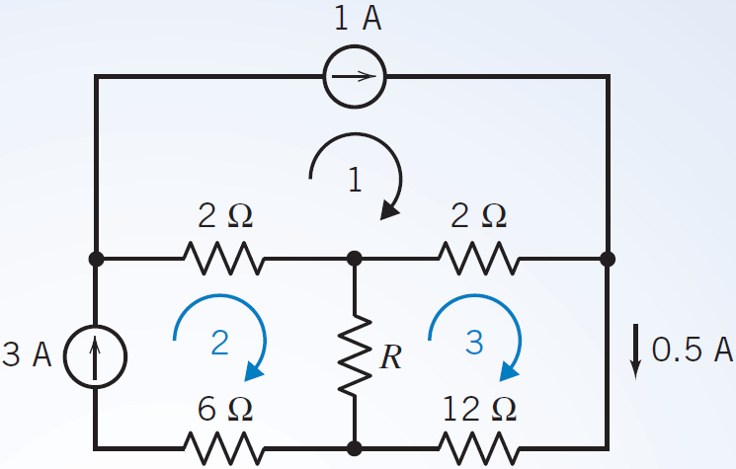



Problem - Solution
The mesh current i₁ is equal to the current in the 1-A current source, so
The mesh current i2 is equal to the current in the 3-A current source, so
The mesh current i3 is equal to the current in the short circuit that replaced the ammeter, so
Apply KVL to mesh 3 to get
Substituting the values of the mesh currents gives

Slide 19
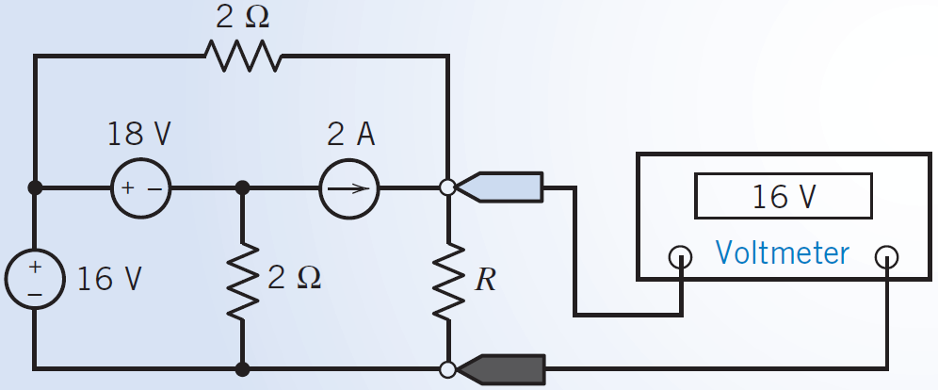
Problem
Consider the circuit shown in Figure. Find the value of the resistance, R.

Slide 20
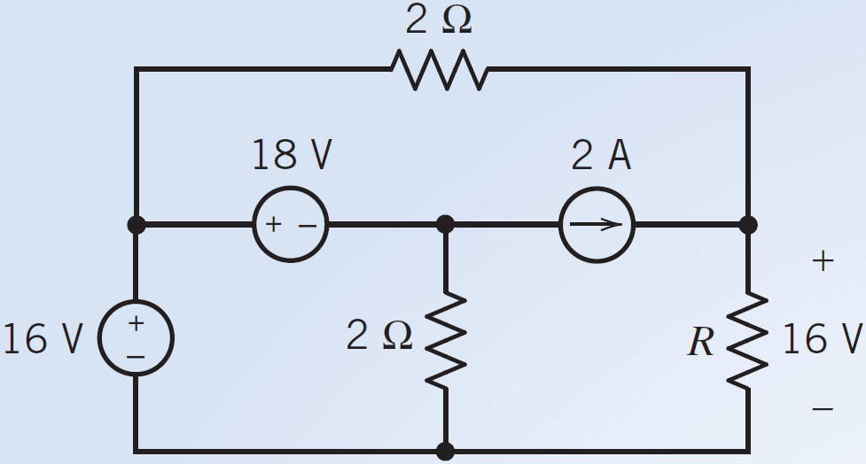
Problem - Solution
Figure shows the circuit after replacing the voltmeter by an equivalent open circuit and labeling the voltage measured by the voltmeter.
This circuit can be analyzed using mesh equations or node equations. To decide which will be easier, we first count the nodes and meshes.
This circuit has four nodes. Selecting a reference node and then applying KCL at the other three nodes will produce a set of three node equations.
The circuit has three meshes. Applying KVL to these three meshes will produce a set of three mesh equations. Analyzing this circuit using mesh equations requires the same number of equations that are required to analyze the circuit using node equations.
Notice that one of the three mesh currents can be determined directly from the current source current, but two of the three node voltages can be determined directly from the voltage source voltages. This makes the node equations easier to solve.
We will analyze this circuit by writing and solving node equations.

Slide 21
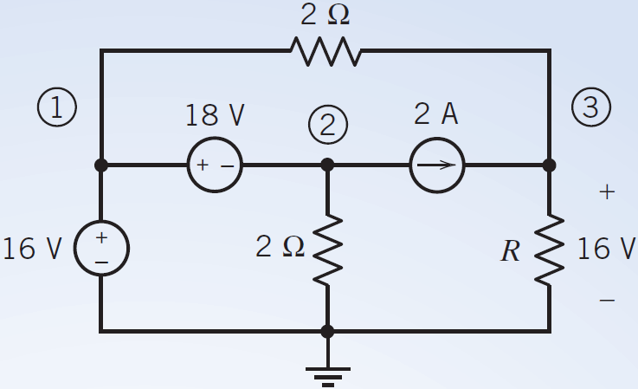

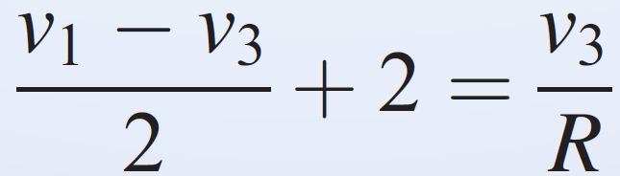
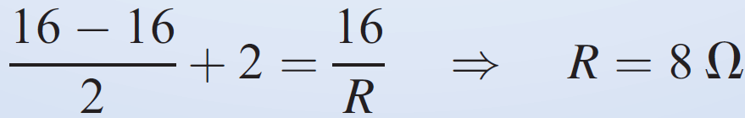
Problem - Solution
The voltage of the 16-V voltage source can be expressed in terms of the node voltages as
The voltage of the 18-V voltage source can be expressed in terms of the node voltages as
The voltmeter measures the node voltage at node 3, so
Applying KCL at node 3 to get
Substituting the values of the node voltages gives

Slide 22
If a circuit has both current sources and voltage sources, it can be analyzed by either method.
One approach is to compare the number of equations required for each method.
If the circuit has fewer nodes than meshes, it may be wise to select the node voltage method. If the circuit has fewer meshes than nodes, it may be easier to use the mesh current method.
Another point to consider when choosing between the two methods is what information is required. If you need to know several currents, it may be wise to proceed directly with mesh current analysis.

Slide 23
References
R.C. Dorf and James A. Svoboda, “Introduction to Electric Circuits”, 9th ed, John Wiley & Sons, 2013.
D.C. Kulshreshtha, Basic Electrical Engineering, Revised 1st ed, Tata Mc Graw Hill, 2017.
V. K.Mehta, Rohit Mehta, Basic Electrical Engineering, 6th ed, S. Chand Publishing, 2012.

